Slide 1

Learning Objectives
LO1 Explain how employees are paid.
LO2 Calculate hourly employee earnings.
© 2014 Cengage Learning. All Rights Reserved.

Slide 2
Paying Employees
Lesson 12-1
LO1
The amount paid to an employee for every hour worked is called a wage.
A fixed annual sum of money divided among equal pay periods is called a salary.
A commission is a method of paying an employee based on the amount of sales the employee generates.
The total amount paid by a business for an employee’s work, earned by a wage, salary, or commission, is called total earnings.
Total earnings are sometimes referred to as gross pay, gross wages, or gross earnings.

Slide 3
Paying Employees
Lesson 12-1
LO1
A pay period is the number of days or weeks of work covered by an employee’s paycheck.
Examples of pay periods
Every week (weekly)
Every two weeks (biweekly)
Twice a month (semimonthly)
Once a month (monthly)

Slide 4
Paying Employees
Lesson 12-1
LO1
The total amount earned by all employees for a pay period is called a payroll.
The accounting staff position that compiles and computes payroll data and then prepares, journalizes, and posts payroll transactions is called a payroll clerk.

Slide 5
Calculating Employee Hours Worked
Lesson 12-1
LO1
A time clock is a device used to record the dates and times of each employee’s arrivals and departures.

Slide 6
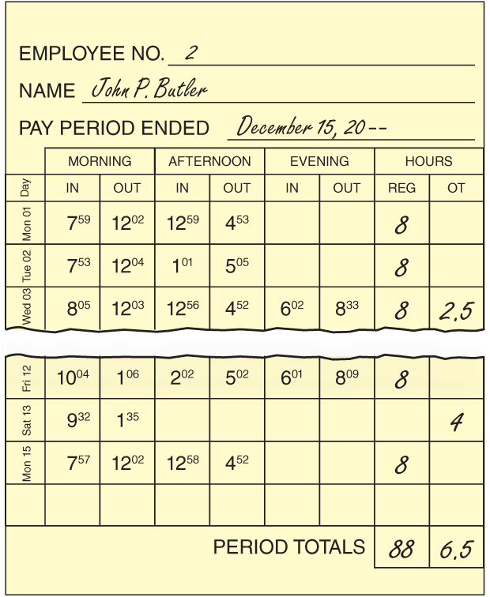
Calculating Employee Hours Worked
Lesson 12-1
LO1
1
Calculate regular hours.
2
Calculate overtime hours.
3
Calculate total hours.

Slide 7
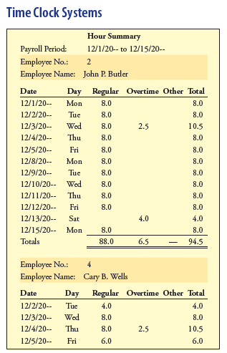
Time Clock Systems
Lesson 12-1
LO1

Slide 8
Calculating Hourly Employee Total Earnings
Lesson 12-1
LO2
1
Calculate regular earnings
Regular Hours | × | Regular Rate | = | Regular Earnings
88 | × | $15.00 | = | $1,320.00
2
Calculate the overtime rate
Regular Rate | × | 1½ | = | Overtime Rate
$15.00 | × | 1½ | = | $22.50
3
Calculate overtime earnings
Overtime Hours | × | Overtime Rate | = | Overtime Earnings
6.5 | × | $22.50 | = | $146.25
4
Calculate total earnings
Regular Earnings | + | Overtime Earnings | = | Total Earnings
$1,320.00 | + | $146.25 | = | $1,466.25

Slide 9

Lesson 12-1 Audit Your Understanding
Lesson 12-1
1. What is a payroll?
ANSWER
The total amount earned by all employees for a pay period

Slide 10
Lesson 12-1 Audit Your Understanding
Lesson 12-1
2. Identify three methods used by modern time clock systems to record employee arrival and departure times.
ANSWER
Employees can swipe their name badges, key in personal identification numbers, or press a finger on a biometric pad to record their arrival or departure.

Slide 11
Lesson 12-1 Audit Your Understanding
Lesson 12-1
3. Describe the overtime rules of the Fair Labor Standards Act.
ANSWER
This act requires most businesses involved in interstate commerce to pay employees at least 1½ times the normal hourly rate for hours worked in excess of 40 hours per week.

Slide 12
Lesson 12-1 Audit Your Understanding
Lesson 12-1
4. How does ThreeGreen calculate overtime earnings?
ANSWER
1½ times the normal hourly rate for hours worked more than 8 hours per day or 40 hours per week

Slide 13
Work Together 12-1 On You Own 12-1
Work Together
12-1 (Word)
Work Together
12-1 (Excel)
Modeled
Page 350
On Your Own
12-1 (Excel)
Complete
Page 350

Slide 14

Learning Objectives
LO3 Demonstrate the process for determining federal income tax withholdings.
LO4 Demonstrate the process for calculating social security and Medicare taxes.
LO5 Explain the benefit of funding medical and retirement plans with pretax contributions.
© 2014 Cengage Learning. All Rights Reserved.

Slide 15
Payroll Taxes
Lesson 12-2
LO3
Taxes based on the payroll of a business are called payroll taxes.

Slide 16
Employee’s Withholding Allowance Certificate
Lesson 12-2
LO3
A deduction from total earnings for each person legally supported by a taxpayer, including the employee, is called a withholding allowance.
Any amount withheld from an employee’s gross earnings is called a payroll deduction.

Slide 17
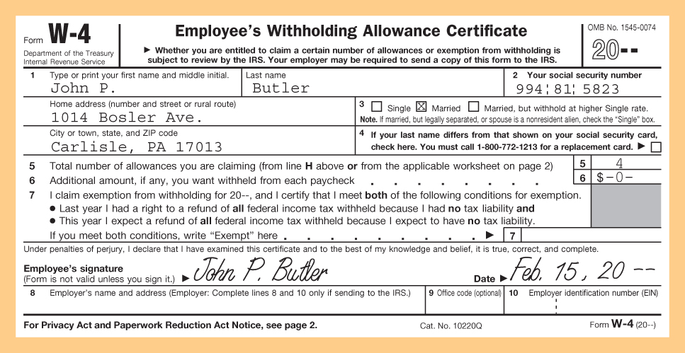
Employee’s Withholding Allowance Certificate
Lesson 12-2
LO3
Marital Status
3
Social Security Number
2
Name and Address
1
4
Withholding Allowances
5
Signature and Date

Slide 18
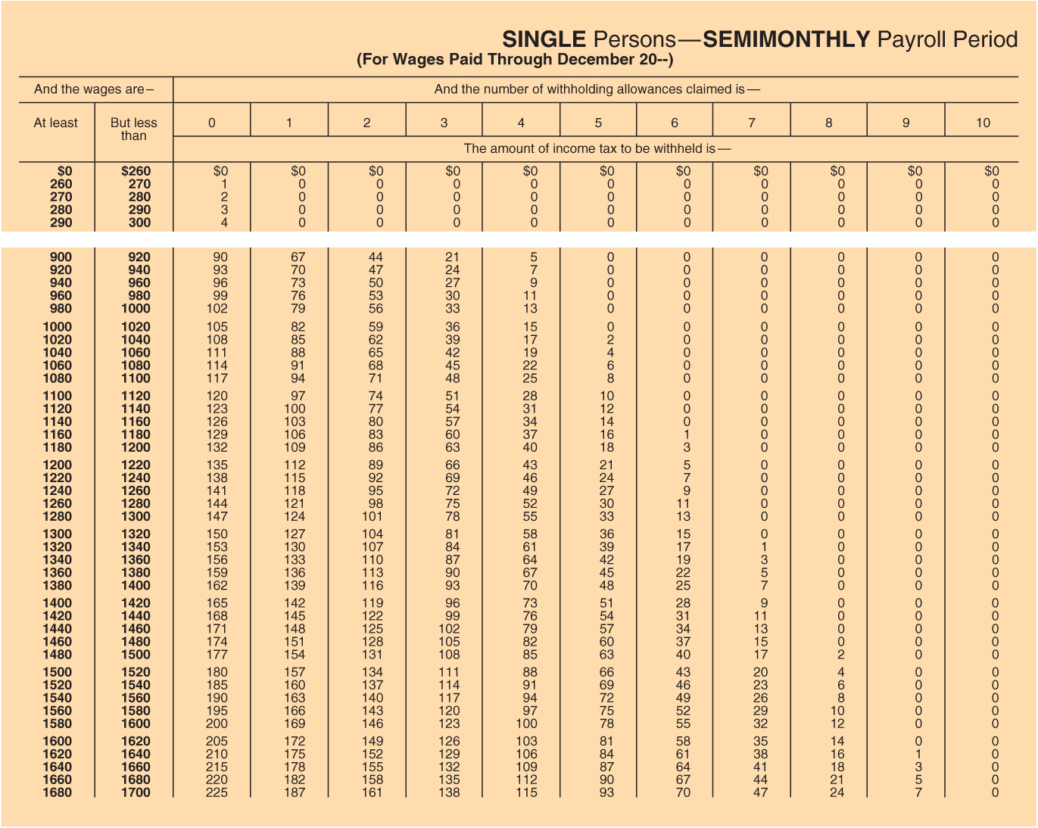
Employee’s Income Tax Withholding—Single Persons
Lesson 12-2
LO3

Slide 19
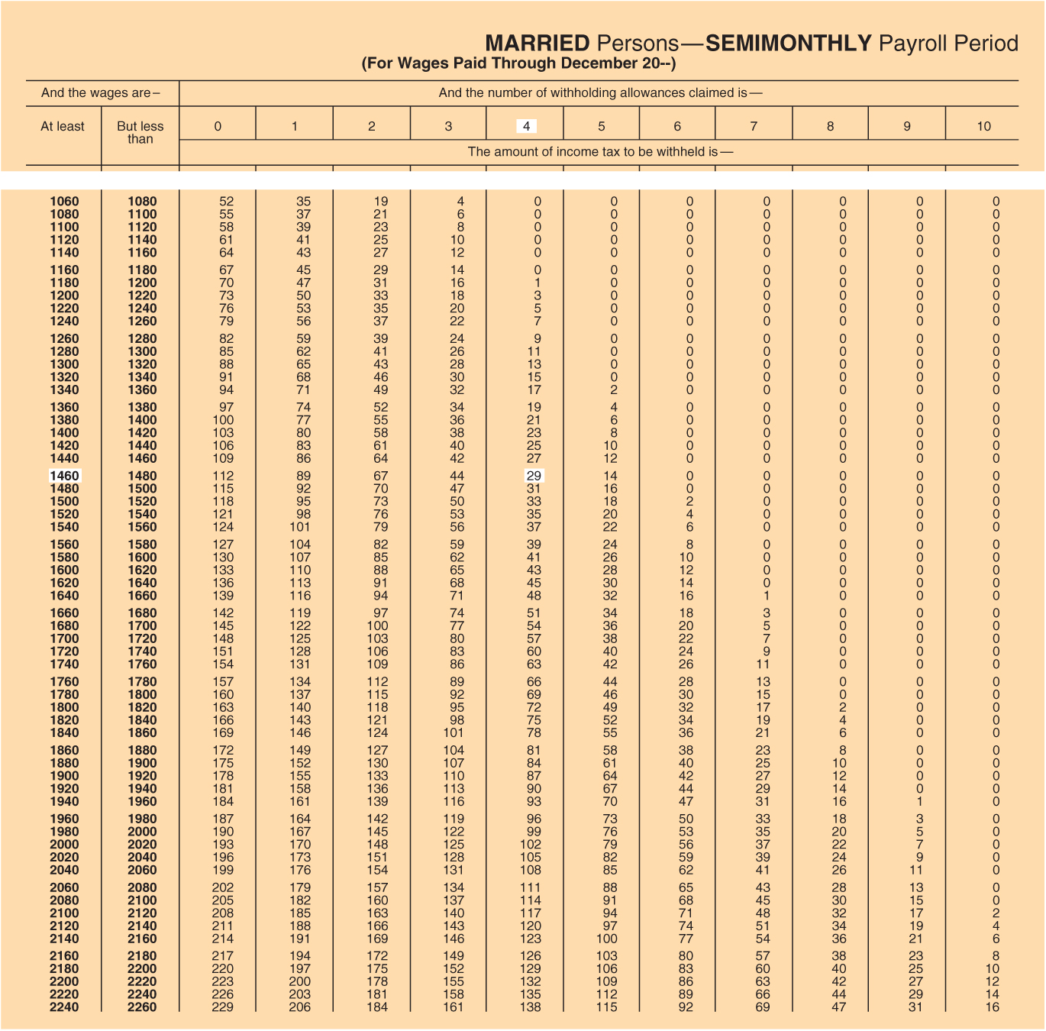
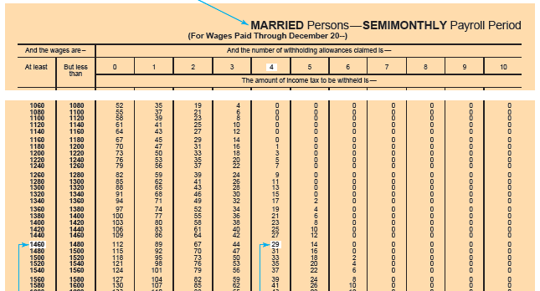
Employee’s Income Tax Withholding—Married Persons
Lesson 12-2
LO3
Select the appropriate table
1
Locate employee’s total earnings
2
Intersection of earnings and withholding allowances
3

Slide 20
Employee Social Security and Medicare Tax
Lesson 12-2
LO4
A federal tax paid for old-age, survivors, and disability insurance is called social security tax.
A federal tax paid for hospital insurance is called Medicare tax.
The total gross earnings year to date for an employee is called accumulated earnings.
The maximum amount of earnings on which a tax is calculated is called a tax base.

Slide 21
Voluntary Deductions from Earnings
Lesson 12-2
LO5
A retirement savings plan approved by the Internal Revenue Service that provides individuals with a tax benefit is called a qualified retirement plan.
A 401(k) is a qualified retirement plan sponsored by an employer.
An individual retirement account (IRA) is a qualified retirement plan that provides most individuals with a deferred federal income tax benefit.
A Roth individual retirement account (Roth IRA) is a qualified retirement plan that allows tax-free withdrawals from the account.

Slide 22
Lesson 12-2 Audit Your Understanding
Lesson 12-2
1. Where does an employer get the information used to determine the amount of federal income tax to withhold from employees’ earnings?
ANSWER
Form W-4, Employee’s Withholding Allowance Certificate

Slide 23
Lesson 12-2 Audit Your Understanding
Lesson 12-2
2. Employee federal income tax withholdings are based on what two factors?
ANSWER
Employee marital status and number of withholding allowances

Slide 24
Lesson 12-2 Audit Your Understanding
Lesson 12-2
3. Does the employer or employee pay social security tax and Medicare tax?
ANSWER
Both the employee and employer pay.

Slide 25
Lesson 12-2 Audit Your Understanding
Lesson 12-2
4. What is the difference in the tax impact of contributions between a 401(k), an IRA , and a Roth IRA?
ANSWER
Only the contributions to a 401(k) and an IRA are deducted from earnings before payroll taxes are calculated.

Slide 26
Lesson 12-2 Audit Your Understanding
Lesson 12-2
5. Are the withdrawals from a 401(k), an IRA , and a Roth IRA subject to income taxes?
ANSWER
The withdrawals from the 401(k) and an IRA are subject to income taxes; withdrawals from a Roth IRA are tax free.

Slide 27
Work Together 12-2 On You Own 12-2
Work Together
12-2 (Excel)
Modeled
Page 357
Use distributed tax table from instructor
On Your Own
12-2 (Excel)
Complete
Page 357
Use distributed tax table from instructor

Slide 28

Learning Objectives
LO6 Prepare a payroll register.
LO7 Prepare employee earnings records.
© 2014 Cengage Learning. All Rights Reserved.

Slide 29
Payroll Register
Lesson 12-3
LO6
A payroll register summarizes the earnings, deductions, and net pay of all employees for one pay period.

Slide 30
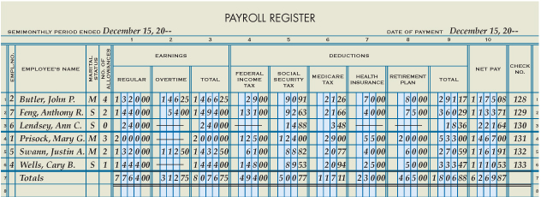
Payroll Register
Lesson 12-3
LO6
Pay Period Date
Social Security Tax
Medicare
Tax
Health
Insurance
Retirement
Plan
Payment
Date
Earnings
1
4
6
7
8
9
2
3
5
12
10
11
13
Employee Personal Data
Federal
Income Tax
Total, Prove,
and Rule
Total
Deductions
Net Pay
Check
Number

Slide 31
Employee Earnings Records
Lesson 12-3
LO7
A business form used to record details of an employee’s earnings and deductions is called an employee earnings record.

Slide 32
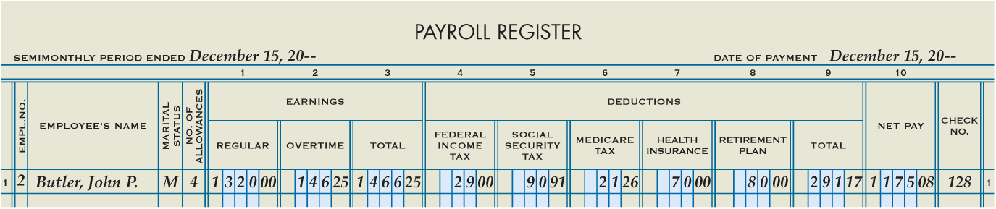
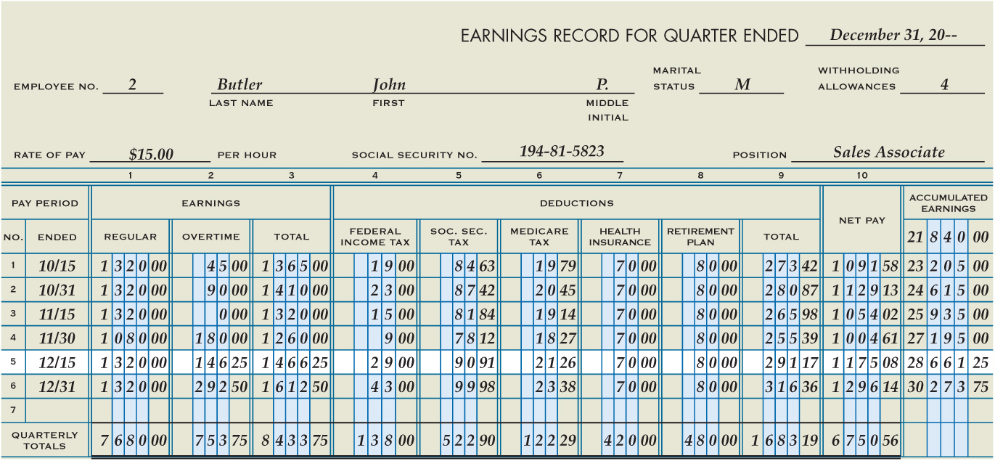
Employee Earnings Records
Lesson 12-3
LO7
2
Employee Personal Data
4
Pay Period
5
Earnings, Deductions, Net Pay
1
Last Day of Quarter
3
Beginning Accumulated Earnings
Updated Accumulated Earnings
6
7
Total and Prove

Slide 33
Lesson 12-3 Audit Your Understanding
Lesson 12-3
1. What does the payroll register summarize?
ANSWER
The payroll register summarizes the payroll for one pay period and shows total earnings, payroll withholdings, and net pay for all employees.

Slide 34
Lesson 12-3 Audit Your Understanding
Lesson 12-3
2. How is net pay calculated?
ANSWER
By subtracting total deductions from total earnings

Slide 35
Lesson 12-3 Audit Your Understanding
Lesson 12-3
3. Why do companies complete employee earnings records?
ANSWER
Because a business must send quarterly and annual reports to federal and state governments showing employee taxable earnings and taxes withheld from employee earnings

Slide 36
Work Together 12-3 On You Own 12-3
Work Together
12-3 & 12-4 (Excel)
Modeled
Page 363
Save
Will need for 12-4
On Your Own
12-3 & 12-4 (Excel)
Complete
Page 363
Save
Will need for 12-4

Slide 37

Learning Objectives
LO8 Justify the use of a payroll checking account.
LO9 Prepare employee payroll checks.
© 2014 Cengage Learning. All Rights Reserved.

Slide 38
Payroll Bank Account
Lesson 12-4
LO8
A voucher check has a detachable check stub, or voucher, that contains detailed information about the cash payment.

Slide 39
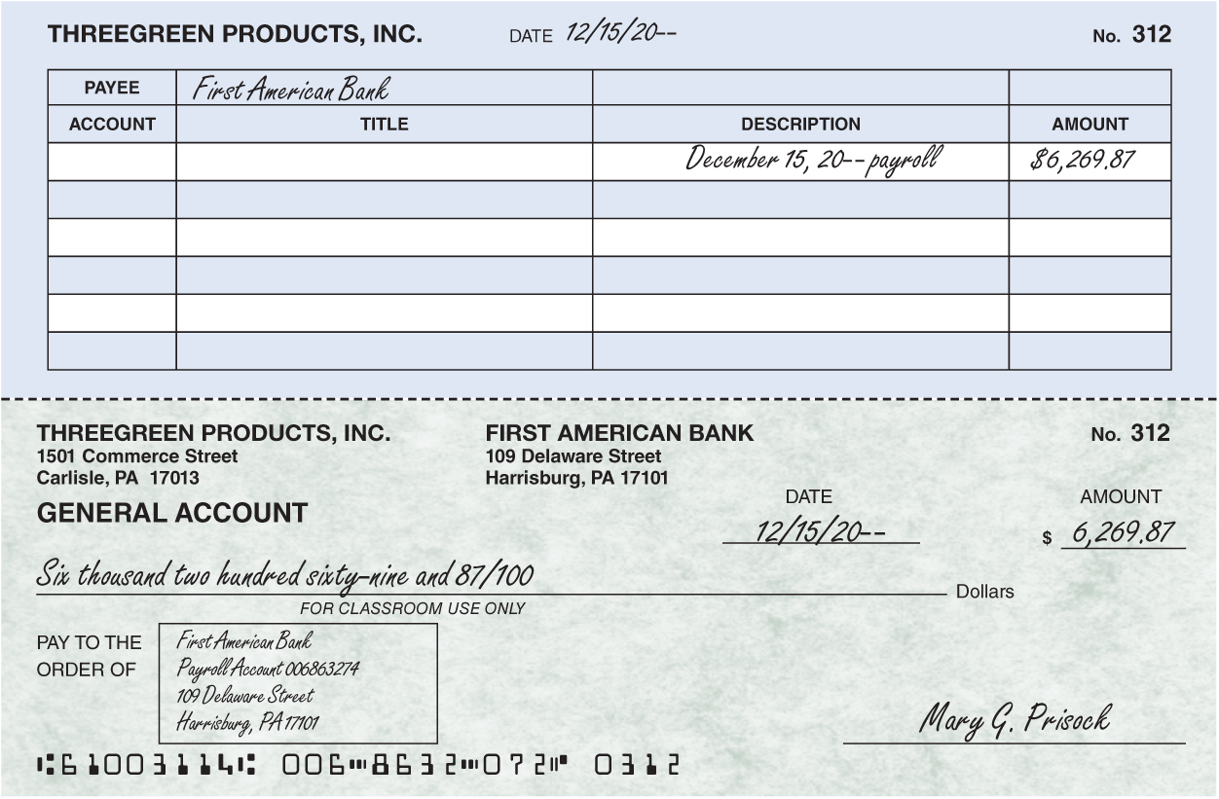
Payroll Bank Account
Lesson 12-4
LO8
Date
Payee
1. Prepare the check stub.
Description
Amount
2. Prepare the check from the information on the check stub.

Slide 40
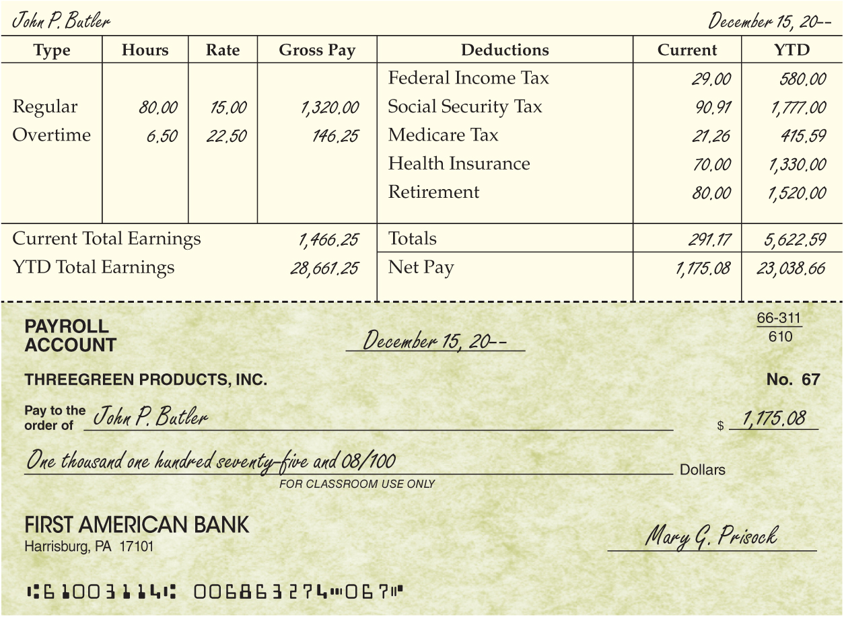
Employee’s Payroll Check
Lesson 12-4
LO9
1. Enter earnings information from the payroll register and the employee’s time card.
2. Enter the YTD Total Earnings from the employee earnings record.
3
4
1
3. Enter the employee’s current deductions from the payroll register and record the total.
5
2
4. Add each current deduction amount to the YTD amount reported on the employee’s prior check stub and record the total.
6
5. Total the Current and YTD deductions columns. Calculate and enter the amounts for Current and YTD net pay.
6. Prepare each employee’s payroll check payable for the amount of net pay.

Slide 41
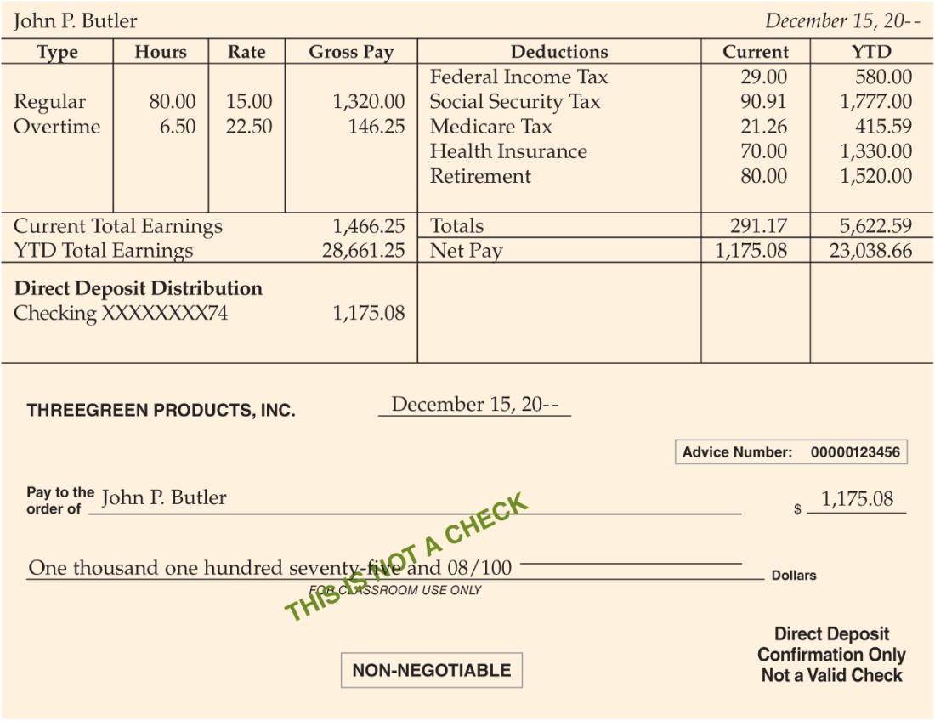
Electronic Funds Transfer
Lesson 12-4
LO9
The payment of an employee’s net pay using electronic funds transfer is called direct deposit.

Slide 42
Lesson 12-4 Audit Your Understanding
Lesson 12-4
1. Why does ThreeGreen have a separate checking account for payroll checks?
ANSWER
1. A separate checking account is used to help protect and control payroll payments.
2. Payroll checks require space to record earnings and deduction information.

Slide 43
Lesson 12-4 Audit Your Understanding
Lesson 12-4
2. What is the source of the information that is recorded on each employee’s payroll check voucher?
ANSWER
The payroll register, employee earnings record, and prior pay period paycheck stub

Slide 44
Lesson 12-4 Audit Your Understanding
Lesson 12-4
3. How do payroll procedures differ for employees who request direct deposit of their pay?
ANSWER
Each employee’s net pay is deposited to his or her bank account. Individual checks are not written and do not have to be distributed. However, each direct deposit employee will receive a printed or electronic statement of earnings and deductions that supports the amount deposited.

Slide 45
Work Together 12-4 On You Own 12-4
Work Together
12-3 & 12-4 (Excel)
Modeled
Page 368
Continued from 12-3
3 Pages Printed Out
Print/Complete
On Your Own
12-3 & 12-4 (Excel)
Complete
Page 368
Continued from 12-3
3 Pages Printed Out
Print/Complete

Slide 46
Application Problems
12-1 Application Problem
Excel
12-2 Application Problem
Excel
12-3 Application Problem
Self Correcting Excel

Slide 47
Application Problems
12-4 Application Problem
Excel (Print/Complete)
3 Pages Printed Out
12 Mastery Problem
Self Correcting Excel

Slide 48
Unit 12 Assessment
Unit 12 Review (ExamView)
90 % or Greater
5 Point Bonus on Unit 1 Concept Quiz (20% Bonus)
Unit 12 Part 1 Quiz (ExamView)
Concepts – 25 Questions (25 Points)
Unit 12 Part 2 Quiz (Excel)
Skills (30 Points)

